Slide 1
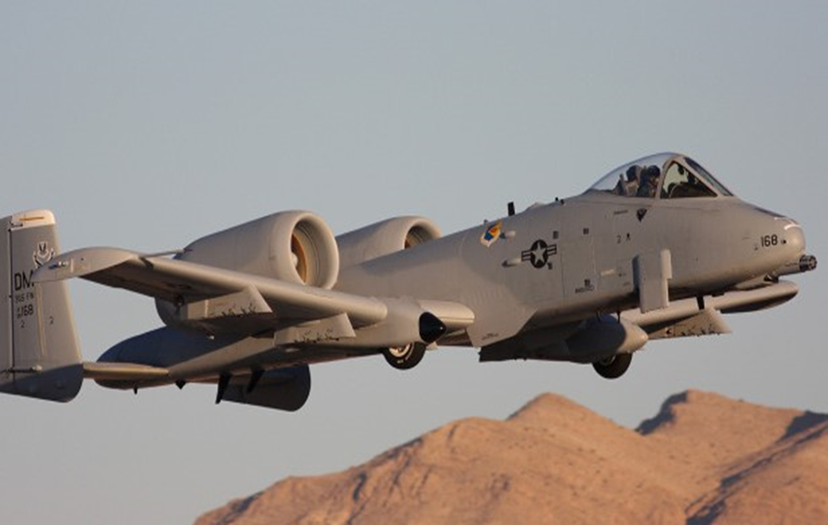
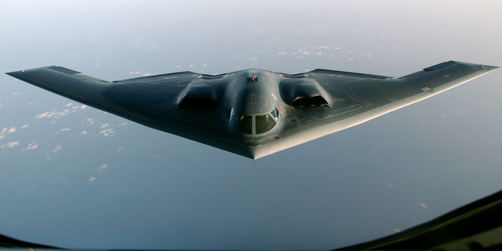
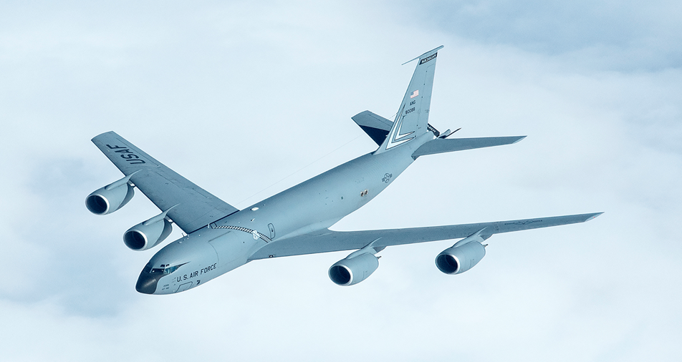
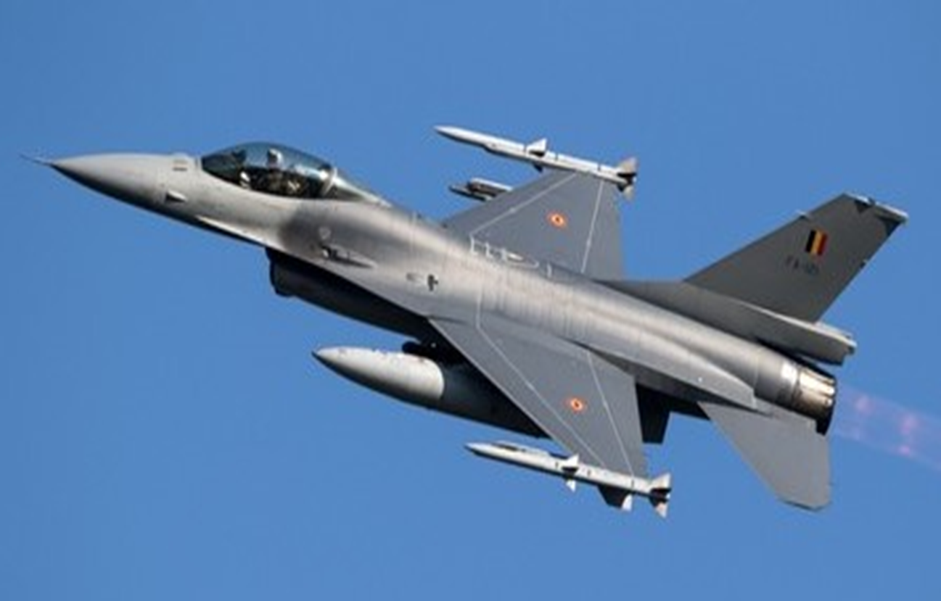
Tinker AFB Opportunities
A-10
B-2
KC-135
F-16

Slide 2
Prism, Optical: Mkt Research Tinker AFB – 422nd SCMS
MD: | A-10
TMS: | N/A
Noun: | Prism, Optical
NSN: | 6650-01-493-3660
P/N: | 2024166-44
Forecasted Buy Price: | Not Available
Forecasted Repair Cost: | Not Available
AAC: | Z
Unserv. Assets Avail: | No
QPA/APPL Rate: | Not Available | Not Available
AMC/AMSC: | 3 | Q
RMC/RMSC: | N/A | N/A
Material: | Crown Glass (JAN-G-174)
Dimensions: | Not Available
Drawings Releasable: | No
Drawing #: | N/A
Drawing Cage Code: | N/A
T.O. Releasable: | No
T.O. #: | Not Available
Budget Code: | 9
Next Higher Asmbly: | Not Available
Out Year Requirements: BUY
FY24: | 15 | FY25: | 6 | FY26: | 6 | FY27: | 6 | FY28: | 6
Out Year Requirements: REPAIR
FY24: | 0 | FY25: | 0 | FY26: | 0 | FY27: | 0 | FY28: | 0
EDL: | Not Available |  |  |  |  | RDL: | Not Available
Tinker | 08/08/2024 |  |  |  |  | Robins | ------
Hill | ------ |  |  |  |  | Virtual | ------
Comments
Interested vendors should submit a Capabilities Statement to 429SCMS.SASPO.Workflow@us.af.mil
No Source Approval Request (SAR) Package required

Slide 3
Hydraulic Motor-Pump Piston: Rev Engineering Tinker AFB – 422nd SCMS
MD: | F-16
TMS: | N/A
Noun: | Hydraulic Motor-Pump Piston
NSN: | 1650-01-254-0044
P/N: | 737225GC
Forecasted Buy Price: | $421.56
Forecasted Repair Cost: | $0.00
AAC: | Z
Unserv. Assets Avail: | No
QPA/APPL Rate: | Not Available | Not Available
AMC/AMSC: | 3 | P
RMC/RMSC: | N/A | N/A
Material: | Not Available
Dimensions: | Not Available
Drawings Releasable: | No
Drawing #: | Not Available
Drawing Cage Code: | Not Available
T.O. Releasable: | No
T.O. #: | Not Available
Budget Code: | 9
Next Higher Asmbly: | Not Available
Out Year Requirements: BUY
FY24: | 3002 | FY25: | 3002 | FY26: | 3002 | FY27: | 3002 | FY28: | 3002
Out Year Requirements: REPAIR
FY24: | 0 | FY25: | 0 | FY26: | 0 | FY27: | 0 | FY28: | 0
EDL: | Not Available |  |  |  |  | RDL: | Not Available
Tinker | 08/08/2024 |  |  |  |  | Robins | ------
Hill | ------ |  |  |  |  | Virtual | ------
Comments
Deliverables: Complete Technical Data Package, Prototype, 3D Modeling Data, Testing Procedures.
White Papers: Interested vendors should submit a White Paper to 429SCMS.SASPO.workflow@us.af.mil
Technical Discussion: RSVP for Technical Discussion

Slide 4
Hydraulic Motor-Pump Piston: Rev Engineering Tinker AFB – 422nd SCMS
Additional Comments
Interested vendors must be able to obtain a licensing agreement from the OEM
Manufacturer is unable to meet current supply demands due to capacity.
If you would like to participate in the Technical Discussion on:
September 17, 2024
provide the following, NLT
August 30, 2024
429SCMS.SASPO.Workflow@us.af.mil
-Company, -Address, -Name(s), -Email(s), -Phone,
-Your questions for Engineering, and
-Statement of Capabilities

Slide 5
Additional Tinker AFB Opportunities
Hose Assembly, Non-metallic: AS – New Buy – B-2
NSN: 4720-01-362-3481, P/N: DAA3515A011-017
Hose Assembly, Non-metallic: AS – New Buy – B-2
NSN: 4720-01-362-3482, P/N: DAA3515A011-019
Hose Assembly, Non-metallic: AS – New Buy – B-2
NSN: 4720-01-362-3483, P/N: DAA3515A012-017
Hose Assembly, Non-metallic: AS – New Buy – B-2
NSN: 4720-01-362-5654, P/N: DAA3515A012-019
Hose Assembly, Non-metallic: AS – New Buy – B-2
NSN: 4720-01-362-5655, P/N: DAA3515A013-017
Hose Assembly, Non-metallic: AS – New Buy – B-2
NSN: 4720-01-362-5656, P/N: DAA3515A013-019

Slide 6
Additional Tinker AFB Opportunities
Hose Assembly, Non-metallic: AS – New Buy – B-2
NSN: 4720-01-362-5657, P/N: DAA3515A014-009
Hose Assembly, Non-metallic: AS – New Buy – B-2
NSN: 4720-01-362-3480, P/N: DAA3515A010-009
Lightning Arrestor – Reverse Engineering – KC135
NSN: 5920-00-677-9869, P/N: 10-2701-1
Switch, Push-Pull – Reverse Engineering – KC-135
NSN: 5930-00-556-3791, P/N: 10-1237-5
Temp Indicator – Reverse Engineering – KC-135
NSN: 6685-00-553-4726, P/N: MIL-I-6533A / 162B2
Ammeter – Reverse Engineering – KC-135
NSN: 6625-01-541-5288, P/N: 135-SP20

Slide 7
Additional Tinker AFB Opportunities
Hydraulic Motor-Pump Piston: Reverse Engineering – F-16
NSN: 1650-01-254-0045, P/N: 737225GA
Hydraulic Motor-Pump Piston: Reverse Engineering – F-16
NSN: 1650-01-254-0046, P/N: 737225GH
Hydraulic Motor-Pump Piston: Reverse Engineering – F-16
NSN: 1650-01-254-0047, P/N: 737225GD
Hydraulic Motor-Pump Piston: Reverse Engineering – F-16
NSN: 1650-01-706-3382, P/N: 766499G3
Hydraulic Motor-Pump Piston: Reverse Engineering – F-16
NSN: 1650-01-706-1551, P/N: 766499G1
Cylinder Block Unit, Hydraulic Motor-Pump: AS – Market Research – F-16
NSN: 1650-01-254-0116, P/N: 714051

Slide 8
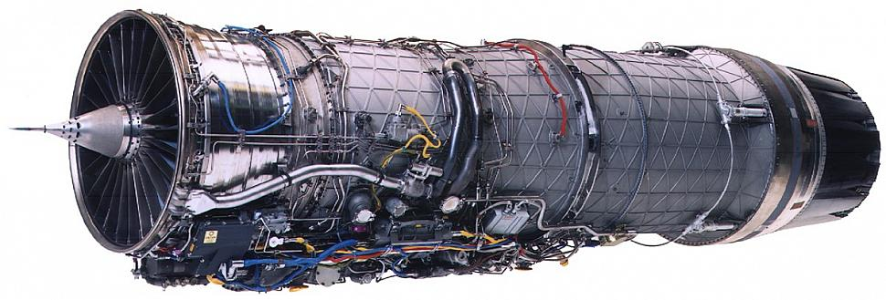
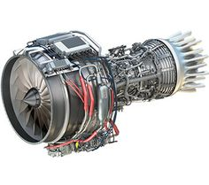
Tinker AFB Engine Opportunities

Slide 9
Additional Tinker AFB Engine Opportunities
Bearing, Ball, Annular – Market Research – F100
NSN: 3110-00-345-6121, P/N: 4037050
Bearing, Ball, Annular - Market Research – F100
NSN: 3110-00-345-6018, P/N: 4035594
Bearing, Roller - Market Research – F100
NSN: 3110-01-137-2472, P/N: 4059349
Air Seal #3 Bearing - Market Research – F100
NSN: 2840-01-381-6850, P/N: 4080811
Bearing, Ball, Annular - Market Research – F100
NSN: 3110-01-388-9826, P/N: 4081024
Bearing, Ball, Annular - Market Research – F100
NSN: 3110-01-319-6269, P/N: 4075314

Slide 10
Additional Tinker AFB Engine Opportunities
Bearing, Roller – Market Research – F100
NSN: 3110-00-416-9422, P/N: 4035597
Divergent Segment - Market Research – F100
NSN: 2840-01-308-4465, P/N: 4071142
Duct, Compressor, Air 4th Stage - Market Research – F100
NSN: 2840-01-443-5588, P/N: 4082871-02
Duct, Compressor, Air 5th Stage - Market Research – F100
NSN: 2840-01-443-5589, P/N: 4082851
Duct, Compressor, Air 6th Stage - Market Research – F100
NSN: 2840-01-443-5590, P/N: 4082849
Duct, Compressor, Air 4th Stage - Market Research – F100
NSN: 2840-01-451-9636, P/N: 4082871-01

Slide 11
Additional Tinker AFB Engine Opportunities
7th Stage Stator - Market Research – F100
NSN: 2840-01-368-3960, P/N: 4083877-01
7th Stage Stator - Market Research – F100
NSN: 2840-01-368-6493, P/N: 4083877-02
7th Stage Stator - Market Research – F100
NSN: 2840-01-619-5781, P/N: 4089077-02
7th Stage Stator - Market Research – F100
NSN: 2840-01-619-3223, P/N: 4089077-01
9th Stage Stator - Market Research – F100
NSN: 2840-01-619-7382, P/N: 4089079-01
9th Stage Stator - Market Research – F100
NSN: 2840-01-368-0006, P/N: 4083979-01

Slide 12
Additional Tinker AFB Engine Opportunities
10-12th Stage Stator - Market Research – F100
NSN: 2840-01-619-7385, P/N: 4089080-04
10-12th Stage Stator - Market Research – F100
NSN: 2840-01-619-7383, P/N: 4089080-01
10-12th Stage Stator - Market Research – F100
NSN: 2840-01-619-4075, P/N: 4089080-03
10-12th Stage Stator - Market Research – F100
NSN: 2840-01-619-4072, P/N: 4089080-02
10-12th Stage Stator - Market Research – F100
NSN: 2840-01-369-6008, P/N: 4083880-01
10-12th Stage Stator - Market Research – F100
NSN: 2840-01-369-1666, P/N: 4083880-03

Slide 13
Additional Tinker AFB Engine Opportunities
10-12th Stage Stator - Market Research – F100
NSN: 2840-01-365-6878, P/N: 4083880-04
10-12th Stage Stator - Market Research – F100
NSN: 2840-01-365-2209, P/N: 4083880-02
4th Stage Vane - Market Research – F100
NSN: 2840-01-317-2242, P/N: 4075854 / 4075974
5th Stage Vane, Compressor - Market Research – F100
NSN: 2840-01-365-0119, P/N: 4080325
6th Stage Vane - Market Research – F100
NSN: 2840-01-344-9149, P/N: 4080256 / 4079696
Inlet Guide Vane - Market Research – F100
NSN: 2840-01-321-4455, P/N: 4077250

Slide 14
Additional Tinker AFB Engine Opportunities
Duct, Compressor, Air - Market Research – F100
NSN: 2840-01-445-5777, P/N: 4082848
Retaining Strap – AS-New Buy – TF34
NSN: 5340-01-553-6726, P/N: 3034T18G02

Slide 15
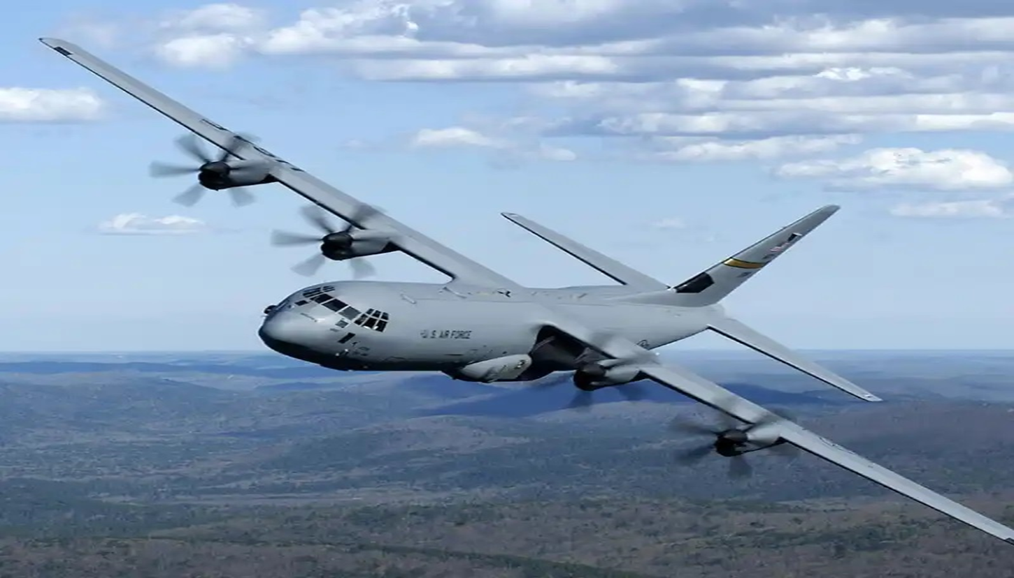
Robins AFB Opportunities
C-130

Slide 16
Intraform Indicator: Reverse Engineering Robins AFB – 409th SCMS
MD: | C-130H
TMS: | N/A
Noun: | Intraform Indicator
NSN: | 5841-01-394-8312
P/N: | 8321-7000-2
Forecasted Buy Price: | $22,785.55
Forecasted Repair Cost: | $5,407.12
AAC: | C
Unserv. Assets Avail: | Yes
QPA/APPL Rate: | 1 | 100%
AMC/AMSC: | 3 | R
RMC/RMSC: | N/A | N/A
Material: | Not Available
Dimensions: | Not Available
Drawings Releasable: | Yes
Drawing #: | 8321-7000
Drawing Cage Code: | 12115
T.O. Releasable: | No
T.O. #: | Not Available
Budget Code: | 8
Next Higher Asmbly: | Main Instrument Panel
Out Year Requirements: BUY
FY24: | 21 | FY25: | 0 | FY26: | 0 | FY27: | 2 | FY28: | 0
Out Year Requirements: REPAIR
FY24: | 0 | FY25: | 0 | FY26: | 0 | FY27: | 0 | FY28: | 0
EDL: | Not Available |  |  |  |  | RDL: | Not Available
Tinker | 08/08/2024 |  |  |  |  | Robins | 3/29/2024
Hill | ------ |  |  |  |  | Virtual | ------
Comments
Deliverables: Complete Technical Data Package to enable manufacture & repair, Prototypes, complete flight testing
certification to include EMI/C, environmental, acceptance,
ground and flight testing.
White Papers: Interested vendors should submit a White Paper to 429SCMS.SASPO.workflow@us.af.mil
Technical Discussion: RSVP for Technical Discussion

Slide 17
Intraform Indicator: Reverse Engineering Robins AFB – 409th SCMS
Additional Comments
The Government has a need to procure NSN 5841-01-394-8312LG. The Government recently tried to award a 5-year procurement contract to DRS ICAS, LLC, but they are unwilling to start producing these again. These assets are currently being repaired by INTERNATIONAL ENTERPRISES, INC. (IEI), but if spares are not added to the supply chain, the supply will eventually run out as parts are deemed “uneconomical to repair”.
The Technical Discussion for this item
has already taken place. If you have questions regarding this item,
please submit them to
429SCMS.SASPO.Workflow@us.af.mil

Slide 18
Additional Robins AFB Opportunities
Power Switching Unit – Reverse Engineering – C-130
NSN: 6110-01-432-0353, P/N: 697873-3 (Lockheed) – CSV4160-4 (GE)
Air Speed Indicator – Reverse Engineering – C-130
NSN: 6610-01-236-1400, P/N: 532-38105-202
Pressure Indicator – Reverse Engineering – C-130
NSN: 6620-01-394-4019, P/N: 10401N01P00

Slide 19

Hill AFB Opportunities
KC-135

Slide 20
APU Turbine Engine: AS - Repair Hill AFB – 419th SCMS
MD: | KC-135
TMS: | N/A
Noun: | Auxiliary Power Unit (APU) Turbine Engine
NSN: | 2835-01-607-1588
P/N: | 161331-135A
Forecasted Buy Price: | $436,796.59
Forecasted Repair Cost: | $327,581.07
AAC: | C
Unserv. Assets Avail: | Yes
QPA/APPL Rate: | 2 | 100%
AMC/AMSC: | 3 | R
RMC/RMSC: | Not Available | Not Available
Material: | Not Available
Dimensions: | Not Available
Criticality Code: | X
Drawings Releasable: | No
Drawing #: | Not Available
Drawing Cage Code: | Not Available
T.O. Releasable: | Yes
T.O. #: | 2G-T62T-43/-44
Budget Code: | 8
Next Higher Asmbly: | Quick Start Auxiliary Power System (QSAS)
Out Year Requirements: BUY
FY24: | 0 | FY25: | 0 | FY26: | 0 | FY27: | 0 | FY28: | 0
Out Year Requirements: REPAIR
FY24: | 36-60 | FY25: | 36-60 | FY26: | 36-60 | FY27: | 36-60 | FY28: | 36-60
EDL: | Available |  |  |  |  | RDL: | Not Available
Tinker | 8/10/2023 |  |  |  |  | Robins | 03/29/2024
Hill | 12/7/2023 |  |  |  |  | Virtual | ------
Comments
Deliverables: Source Approval Request (SAR) Package
Interested vendors should submit a Source Approval Request (SAR) to AFSC.OL.SB@us.af.mil and include your email address and “request a drop off”. A request for drop off will be returned, use this to submit your SAR package.

Slide 21
APU Turbine Engine: AS - Repair Hill AFB – 419th SCMS
Additional Comments
In the past 5 years, the current source has struggled to overhaul KC 135 APU to meet Air Force requirements, resulting in increased backorders. A supplementary overhaul source would alleviate both the backlog of backorders and help maintain a constant supply of APUs to the warfighter.
A licensing agreement with Pratt and Whitney must be obtained in order to request available drawing from the Public Sales Office.

Slide 22
Acronym Legend
AAC – Acquisition Advice Code
AMC – Acquisition Method Code
AMSC – Acquisition Method Suffix Code
APPL – Application Rate
AS – Alternate Source
Asmbly - Assembly
MD – Mission Designation (Aircraft Type)
N/A – Not Applicable
NSN – National Stock Number
OTA – Other Transactional Authority
QPA – Quantity Per Assembly

Slide 23
Acronym Legend
Rev Eng – Reverse Engineer
RMC – Repair Method Code
RMSC – Repair Method Suffix Code
TMS – Type, Model and Series (Engines Only)
T.O. – Technical Order
Unserv. Assets Avail – Unserviceable Assets Available

